Slide 1
Delaware, the Center of the Universe (Or Is It?)
Delaware Trust Conference October 28, 2024 Wilmington, Delaware
24060381v3 9.16..2024

Slide 2
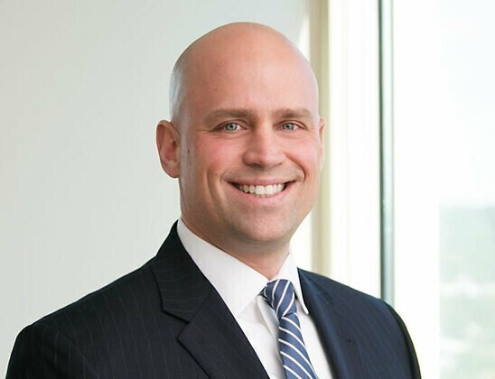
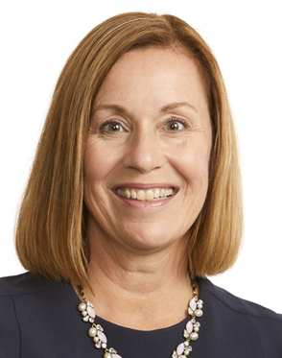
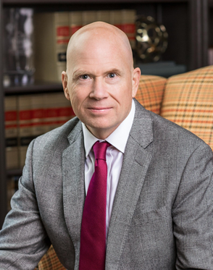
Here with you today
Suzanne Shier
J. Zachary Haupt
Wendy Zimmer Cox
Bill Kelleher
COUNSEL LEVENFELD PEARLSTEIN, LLC
sshier@lplegal.com (312) 476-7505
SPECIAL COUNSEL
MORRIS, NICHOLS, ARSHT
& TUNNELL LLP
zhaupt@morrisnichols.com (302) 351-9424
DIRECTOR OF PERSONAL TRUST, CHIEF FIDUCIARY OFFICER
GREENLEAF TRUST
wcox@greenleaftrust.com (248) 530-6208
DIRECTOR
GORDON, FOURNARIS
& MAMMARELLA, P.A.
bkelleher@gfmlaw.com (302) 652-1142

Slide 3
Delaware, the Center of the Universe (Or Is It?)
Delaware’s trust laws, wealth management industry, and judicial system have placed Delaware in the center of the trust universe, but clients may feel a gravitational pull from competing jurisdictions in Delaware’s orbit.
In this session we will explore elements impacting the atmosphere of Delaware and competing jurisdictions, including:
Laws providing flexibility to draft and modify governing instruments,
Laws affecting the management of fiduciary risk,
State judicial systems,
and much more.

Slide 4
Applicable Law
For purposes of this discussion, we will look to the law of Delaware and the various uniform laws related to trusts, including:
Uniform Trust Code
Uniform Trust Decanting Act
Uniform Directed Trust Act
Uniform Prudent Investor Rule
The Uniform Fiduciary Income and Principal Act

Slide 5
Uniform Prudent Investor Act
Earliest trust-related uniform law, based in part on the prior adopted Illinois Prudent Investor Act.
Enacted, per the Uniform Laws Commission, in 46 states.
Not enacted as a uniform law in Delaware.

Slide 6
Uniform Trust Code
Enacted per the Uniform Laws Commission in 36 states.
Not enacted in Delaware.

Slide 7
Uniform Trust Decanting Act
Enacted per the Uniform Laws Commission in 18 states.
Introduced in 2 additional states.
Not enacted or introduced in Delaware.

Slide 8
Uniform Directed Trust Act
Enacted per the Uniform Laws Commission in 20 states.
Introduced in 1 additional state.
Not enacted or introduced in Delaware.

Slide 9
Uniform Fiduciary Income and Principal Act
Enacted per the Uniform Laws Commission in 8 states.
Introduced in 1 state.
Predecessor Uniform Principal and Income Acts 2000 and 2008 widely enacted.
2008 Act enacted in Delaware.

Slide 10
Providing for the Benefit of the Beneficiary
Notices, accounts, representation

Slide 11
Providing for the Benefit of the Beneficiary
 | Delaware | Uniform Trust Code | Illinois Trust Code | Michigan Trust Code
Duty to Inform | Common Law (see McNeil) | § 813 | §§ 813.1, 813.2 | § 700.7814
Silent Trusts | 12 Del. C. § 3303(c) | § 105(b)(8)-(9) | § 105(b)(10)-(12) (not permitted) | § 700.7409(a)
Designated Representatives | 12 Del. C. §§ 3303(d), 3339 | Art. 3 | § 307 | N/A
Virtual Representation | 12 Del. C. § 3547 | § 304 | § 304 | § 700.7304
Beneficiary Well-Being Trust | 12 Del. C. § 3345

Slide 12
Duty to Inform
Delaware
“A trustee has a duty to furnish information to a beneficiary upon reasonable request. Furthermore, even in the absence of a request for information, a trustee must communicate essential facts, such as the existence of the basic terms of the trust. That a person is a current beneficiary of a trust is indeed an essential fact.” McNeil v. McNeil, 798 A.2d 503 (Del. 2002).
UTC § 813 Duty to Inform
(a) A trustee shall keep the qualified beneficiaries of the trust reasonably informed about the administration of the trust and of the material facts necessary for them to protect their interests. Unless unreasonable under the circumstances, a trustee shall promptly respond to a beneficiary’s request for information related to the administration of the trust.
Notes:
TO WHOM?
ALL BENEFICIARIES -- CURRENT, PRESUMPTIVE REMAINDER, CONTINGENT?
ONLY SOME BENEFICIARIES?
WHAT?
TO QUALIFIED BENEFICIARIES (CURRENT AND PRESUMPTIVE REMAINDER) –AFFIRMATIVE DUTY TO NOTIFY OF
THE EXISTENCE OF THE TRUST
RIGHT TO RECEIVE A COPY OF THE TRUST AGREEMENT [RELEVANT PORTION] WHETHER THE BENEFICIARY HAS A RIGHT TO RECEIVE OR REQUEST AN ACCOUNTING
ADVANCE NOTICE OF CHANGE IN METHOD/RATE OF TRUSTEE’S COMPUTATION
ANNUAL REPORT TO CURRENT BENEFICIARIES
UPON REQUEST TO OTHER BENEFICIARIES – QUALIFIED AND NON QUALIFIED
WHEN?
WITHIN 60 [90] DAYS OF TRUST BECOMING IRREVOCABLE OR TRUSTEE’S ACCEPTANCE OF TRUSTEESHIP; 60 [90] DAYS OF TRUSTEE KNOWING A QUALIFIED BENEFICIARY HAS A REPRESENTATIVE WHO DID RECEIVE NOTICE; 60 [90] DAYS OF A REPRESENTATIVE NOT ACTING FOR A QUALIFIED BENEFICIARY
WAIVER – A BENEFICIARY MAY WAIVE AND WITHDRAW WAIVER

Slide 13
Silent Trusts
Delaware -- 12 Del. C. § 3303(c)
The terms of a governing instrument may expand, restrict, eliminate, or otherwise vary the right of a beneficiary to be informed of the beneficiary’s interest in a trust for a period of time, including but not limited to:
A period of time related to the age of a beneficiary;
A period of time related to the lifetime of each trustor and/or spouse of a trustor;
A period of time related to a term of years or specific date; and/or
A period of time related to a specific event that is certain to occur.
UTC § 105(b)(8)-(9) Default and Mandatory Rules
The terms of a trust prevail over any provision of the UTC, with exceptions which specifically include the duty to notify certain qualified beneficiaries of the trust, the identity of the trustee, and the right to request reports and the duty to respond to requests for reports and information.
Notes:
NO SILENT TRUST UNDER THE UTC.
DUTY TO NOTIFY QUALIFIED BENEFICIARIES WHO ARE 25 OF EXISTENCE OF TRUST, IDENTITY OF TRUSTEE, AND RIGHT TO REQUEST REPORTS CANNOT BE WAIVED
DUTY TO RESPOND TO QUALIFIED BENEFICIARY REQUEST FOR REPORTS CANNOT BE WAIVED
MODIFIED IN MANY STATES
IN ILLINOIS CANNOT MODIFY NOTICE TO QUALIFIED BENEFICIARIES OR ACCOUNTING TO CURRENT BENEFICIARIES

Slide 14
Designated Representatives
Delaware -- 12 Del. C. § § 3303(d) and 3339
Designated Representatives (DR) may be appointed:
Pursuant to express provision in governing instrument;
By person empowered to appoint a DR under governing instrument;
By the trustor (with exceptions and restrictions); or
By the beneficiary.
DR may represent and bind for judicial and nonjudicial matters.
UTC
Not provided for under UTC.
A number of states, including Illinois and Florida, have included provision for designated representatives in their trust codes.
In some states with a DR provision, representation of current beneficiaries is age-limited, but representation of presumptive remainder beneficiaries is not age-limited.
Notes:
ITC 307
DESIGNATED REPRESENTATIVE
NAMED IN TRUST AGREEMENT OR APPOINTED PURSUANT TO TRUST AGREEMENT (BY
SOMEONE OTHER THAT THE TRUSTEE)
FOR ANY BENEFICIARY UNDER 30, FOR BENEFICIARY OTHER THAN COMPETENT
BENEFICIARY AGE 30+
PREFER A DESIGNATED REPRESENTATIVE TO A WAIVER
DESIGNATED REPRESENTATIVE CAN RECEIVE NOTICES AND ACCOUNTS, ENTER
BINDING AGREEMENTS AND BIND THE BENEFICIARY
DESIGNATED REPRESENTATIVE CANNOT BE THE TRUSTEE
LIMITS ON WHO MAY BE BOTH A DESIGNATED REPRESENTATIVE AND A BENEFICIARY
ALLOWED IF NAMED IN THE TRUST OR IF THE DR IS THE SPOUSE, GRANDPARENT,
PARENT, SIBLING (CLOSE FAMILY MEMBERS)
DESIGNATED REPRESENTATIVE IS A FIDUCIARY – BUT TRUST CAN CHANGE THIS RULE
IN ILLINOIS (BUT NOT IN FLORIDA)
MUST ACT IN GOOD FAITH
BALANCING THE PROBLEM CHILD SYNDROM

Slide 15
Virtual Representation
Delaware -- 12 Del. C. § 3547
Minors, incapacitated persons, unborn persons, and unascertainable persons may be bound by those who have substantially. identical interest with respect to the particular question or dispute but only to the extent that there is no material conflict of interest.
Presumptive remainder beneficiaries can represent contingent successor remainder beneficiaries and contingent remainder beneficiaries can represent those more remote.
Holders of Powers of Appointments (limited versus general)
Parents of minor and unborn beneficiaries
Designated Representative of a beneficiary may virtually represent those who the beneficiary could represent if representing themself.
UTC § 304 Representation by Person Having Substantially Identical Interest
Unless otherwise represented, a minor, incapacitated person, or unborn individual, or a person whose identity or location is unknown and not reasonably ascertainable, may be represented and bound by another having a substantially identical interest with respect to the particular question or dispute, but only to the extent there is no conflict of interest between the representative and the person represented.
Notes:
OTHER TYPES OF REPRESENTION
HOLDER OF A POWER OF A [GENERAL] TESTAMENTARY POWER OF APPOINTMENT
REPRESENTS PERMISSILBE APPOINTEES AND TAKERS IN DEFAULT
ILLINOIS BROADENS TO BROAD SPECIAL POWER OF APPOINTMENT AND ALSO TO
OTHER POWERS OF APPOINTMENT ABSENT A CONFLICT OF INTEREST
ILLINOIS ALSO INCLUDES HOLDER OF CURRENT POWER OF APPOINTMENT
PARENT, GUADIAN, AGENT POA
SUBTANTIALLY IDENTICAL INTERESTS – FOR REPRESENTATION OF A MINOR,
IN CAPACITATED, UNBORN
ILLINOIS HAS A REPRESENTATION WATERFALL
GUARDIAN AD LITEM
HOLDER OF POWER OF APPOINTMENT
DESIGNATED REPRESENTATIVE
COURT APPOINTED GUARDIAN OF ESTATE/ OR IF NONE, THE PERSON
AGENT UNDER POA PROPERTY
PARENT
PERSON WITH SUBSTANTIALLY SIMILAR INTEREST
REPRESENATIVE OF PERSON WITH SUBSTANTIALLY SIMILAR INTEREST

Slide 16
Beneficiary Well-Being Trust
Delaware – 12 Del. C. § 3345
Only statute of its kind.
Allows settlors to opt-in by making express reference to Section 3345 in a governing instrument.
Entitles beneficiaries to “beneficiary well-being programs,” which are defined broadly in the statute and the definition can be modified in the governing instrument.
Well-being programs have one or more of the following purposes: (1) preparing beneficiaries for inheriting wealth by providing estate and asset planning, assistance with asset transfers, developing wealth management and money skills, financial literacy and acumen, business fundamentals, entrepreneurship, knowledge of family businesses, and philanthropy and/or (2) educating beneficiaries about the beneficiaries’ family history, the family’s values, family governance, family dynamics, family mental health and well-being, and connection among family members.
Costs are paid by the trust and the beneficiary well-being programs may be provided by the trustee, an affiliate or third party without reducing trustee compensation.
New trustee power added at paragraph (32) of Section 3325, which provides trustees of all Delaware trusts with the power to provide financial education services
Notes:
OTHER TYPES OF REPRESENTION
HOLDER OF A POWER OF A [GENERAL] TESTAMENTARY POWER OF APPOINTMENT
REPRESENTS PERMISSILBE APPOINTEES AND TAKERS IN DEFAULT
ILLINOIS BROADENS TO BROAD SPECIAL POWER OF APPOINTMENT AND ALSO TO
OTHER POWERS OF APPOINTMENT ABSENT A CONFLICT OF INTEREST
ILLINOIS ALSO INCLUDES HOLDER OF CURRENT POWER OF APPOINTMENT
PARENT, GUADIAN, AGENT POA
SUBTANTIALLY IDENTICAL INTERESTS – FOR REPRESENTATION OF A MINOR,
IN CAPACITATED, UNBORN
ILLINOIS HAS A REPRESENTATION WATERFALL
GUARDIAN AD LITEM
HOLDER OF POWER OF APPOINTMENT
DESIGNATED REPRESENTATIVE
COURT APPOINTED GUARDIAN OF ESTATE/ OR IF NONE, THE PERSON
AGENT UNDER POA PROPERTY
PARENT
PERSON WITH SUBSTANTIALLY SIMILAR INTEREST
REPRESENATIVE OF PERSON WITH SUBSTANTIALLY SIMILAR INTEREST

Slide 17
Practice Pointers
When there is a choice of jurisdiction, consider the alternatives and make an informed decision to begin with. It is easier to choose that it is to change.
Knowing the documents is always the first step, but knowing the applicable law as to notices, informing and representation is a close second.
Trust acceptance, whether as the original trustee or as a successor trustee, is a critical phase of administration for the determination of the core responsibilities related to notice and information and applicable representation paradigms.
Be aware of trusts migrating from other jurisdictions and take special care.

Slide 18
Managing the Risk of the Fiduciary
Directed trusts, limitations on liability

Slide 19
Managing the Risk of the Fiduciary
 | Delaware | UTC | Illinois | Michigan
Limits on Liability | 12 Del. C. §§ 3303(a), 3588 | §§ 1005-1010 | Article 10 §§ 1005-1010 | § 700.7703, § 700.7610
Limitation of Actions | 12 Del. C. §§ 3585, 3596 | § 1005 | § 1005 | §700.7604 §700.7610 §700.7905
Dissenting Co-Trustees and Excluded Trustees | 12 Del. C. §§ 3323, 3313A | § 703(g), (h) | § 703(g), (h) | § 700.7703 § 700.7703b (7-10)
Directed Trusts | 12 Del. C. § 3313 | § 808/ Uniform Directed Trust Act | § 808 (e)-(f) | § 700.7703a, § 700.7808
Delegation | 12 Del. C. § 3322 | § 807 | § 807 | § 700.7703

Slide 20
Managing the Risk of the Fiduciary
 | Delaware | UTC | Illinois | Michigan
Concentrated Positions/Special Holdings | 12 Del. C. § 3302 | Uniform Prudent Investor Act | UTC Article 9 | § 700.7803 Michigan Prudent Investor Rule

Slide 21
Limits on Liability
Delaware -- 12 Del. C. § 3303(a) – Effect of Provision of Instrument
The terms of a governing instrument may expand, restrict, eliminate, or otherwise vary any laws of general application to fiduciaries … except for willful misconduct.
Delaware -- 12 Del. C. § 3588 – Release, Consent and Indemnification
Releases enforceable without consideration.
UTC
§ 1008 Exculpation of Trustee – limited to extent of relief for breach in bad faith or with reckless indifference.
§ 1009 Beneficiary’s Consent, Release, or Ratification – provide protection unless induced by improper trustee conduct; must be fair and reasonable if related to self-dealing.
§ 1010 Limitation of Personal Liability of Trustee – liability of trustee generally not personal.
Notes:
1008 – TRUST AGREEMENT. CANNOT BE RELIEVED OF BAD FAITH OR RECKLESS
INDIFFERENCE TO THE PURPOSE OF A TRUST OR THE INTEREST OF THE BENEFICIARIES;
UNENFORCEABLE IF ABUSE OF DISCRETION IN CONNECTION WITH EXCULPATION;
INVALID IF DRAFTED/CAUSED TO BE DRAFTED BY TRUSTEE UNLESS PROVED TO BE FAIR
AND EXISTENCE ON CONTENT ADEQUATELY COMMUNICATED TO THE SETTLOR
BAD FAITH- DISHONESTY OR FRAUD
GOOD FAITH – HONEST DEALING
1009 – BENEFICIARY CONSENT, RELEASE, INDEMNIFICATION
NOT LIABLE IF BENEFICIARY CONSENTED RELEASED OR RATIFIED, UNLESS, INDUCED
BY IMPROPER TRUSTEE CONDUCT OR AT TIME GIVE THE BENEFICIARY DID NOT
KNOW OF RIGHTS OR MATERIAL FACTS.
1010 – NOT PERSONALLY LIABLE AS THE BANK OR TRUST COMPANY ON CONTRACT
ENTERED INTO IN FIDUCIARY CAPACITY. INCLUDE SPECIFIC LANGUAGE WHEN SIGNING,
AS TRUSTEE AND NOT INDIVIDUALLY

Slide 22
Limitation of Action
Delaware -- 12 Del. C. § 3585 – Statute of Limitations
1 year following receipt of report
120 days following receipt of report if trustee will cease to serve and if certain notice requirements are met
5 years after the first to occur of (i) the trustee ceasing to serve, (ii) the termination of the person’s interest in the trust, or (iii) the termination of the trust
UTC § 1005 Limitation of Action Against Trustee
A beneficiary may not commence a proceeding against a trustee for breach of trust more than one year after the date the beneficiary or a representative of the beneficiary was sent a report that adequately disclosed the existence of a potential claim for breach of trust and informed the beneficiary of the time allowed for commencing a proceeding.
Notes:
ONE YEAR AFTER RECEIPT BY BENEFICIARY OR REPRESENTATIVE OF BENEFICIARY
REPORT WITH ADEQUATE DISCLOSURE
SUFFICIENT INFORMATION SO BENEFICIAIRY KNOWS OR SHOULD HAVE INQUIRED
LIMITATION PERIOD STATEMENTS IN MONTHLY, QUARTERLY AND ANNUAL ACCOUNT
STATEMENTS
ILLINOIS IS 2 YEARS FOR NEWER TRUSTS AND 3 YEARS FOR OLDER TRUSTS
1[2] YEAR PERIODS DON’T APPLY TO A BENEFICIARY WHO HAS WAIVED NOTICES OR
ACCOUNTS, BUT DOES APPLY IF REPRESENTATIVE RECEIVED
STATUTE OF REPOSE UNDER UTC IS 5 YEARS AFTER REMOVAL, RESIGNATION, DEATH
TRUSTEE, TERMINATION OF BENEFICIARY INTEREST IN TRUST, TERMINATION OF
TRUTS

Slide 23
Various Trustee Roles
Co- Trustees
Dissenting Trustees
Excluded Trustees
Separate Trustees
Directed Trustee
Trust design commonly includes various trustee roles, each with distinct relationships and associated responsibilities.

Slide 24
Dissenting Co-Trustee
Delaware -- 12 Del. C. §3323
A trustee who dissents in writing from the action of the majority of trustees is not liable for the action of the majority.
UTC § 703(g) Co-Trustees
A dissenting trustee who joins in an
action at the direction of the majority
of the trustees and who notified any
co-Trustee of the dissent at or before
the time of the action is not liable for
the action unless the action is a
serious breach of trust.
Notes:
A CO-TRUSTEE HAS NONE OF THE PROTECTIONS OF A DIRECTED OR EXLCUDED
TRUSTEE
A CO-TRUSTEE IS REQUIRED TO EXERCISE REASONABLE CARE TO PREVENT A
CO-TRUSTE FROM COMMITTING A SERIOUS BREACH OF TRUST AND TO COMPEL
A CO-TRUSTEE TO REDRESS A SERIOUS BREACH OF TRUST
MUST PARTICIPATE UNLESS PROPERLY DELEGATED; CAN’T DELEGATE TO THE
EXTENT SETTLOR REASONABLY EXPECTED JOINT ACTION – INDIVIDUAL AND
CORPORATE TRUSTEE
BETTER TO DIVIDE THAN TO DELEGATE

Slide 25
Dissenting Trustee (Cont’d.)
Michigan -- MCL § 700.7703 (7)
A trustee is not liable for the action or omission of a co-trustee if all of the following apply:
The trustee is not unavailable to perform a trustee's function because of absence, illness, disqualification under other law, or other incapacity or has not properly delegated the performance of the function to a co-trustee.
The trustee is aware of but does not join in the action or omission of the co-trustee.
The trustee dissents in writing to each co-trustee at or before the time of the action or omission.
Notes:
A CO-TRUSTEE HAS NONE OF THE PROTECTIONS OF A DIRECTED OR EXLCUDED
TRUSTEE
A CO-TRUSTEE IS REQUIRED TO EXERCISE REASONABLE CARE TO PREVENT A
CO-TRUSTE FROM COMMITTING A SERIOUS BREACH OF TRUST AND TO COMPEL
A CO-TRUSTEE TO REDRESS A SERIOUS BREACH OF TRUST
MUST PARTICIPATE UNLESS PROPERLY DELEGATED; CAN’T DELEGATE TO THE
EXTENT SETTLOR REASONABLY EXPECTED JOINT ACTION – INDIVIDUAL AND
CORPORATE TRUSTEE
BETTER TO DIVIDE THAN TO DELEGATE

Slide 26
Excluded Trustees
Delaware -- 12 Del. C. § 3313A –
No liability absent willful misconduct when acting at direction of a co-Trustee.
No liability when excluded from possession and exercise of specified trustee powers.
Excluded Trustee has no duty to monitor, no duty to provide advice, no duty to communicate or warn as to excluded powers.
Uniform Directed Trust Act (UTDA)
And UTC § 808
Uniform Directed Trust Act supersedes
UTC § 808, which remains in effect in
many states, including Illinois. An
excluded Trustee directed to act by a
directing party as to specific powers is
deemed to be excluded from exercising
those powers and has no duty to monitor,
review, inquire, investigate, recommend,
evaluate or warn with respect to a
directing party’s exercise or failure to
exercise such a power.

Slide 27
Separate Trustees
Michigan - MCL 700.7703b
A separate trustee is not liable for the act or omission of any other separate trustee of the aggregate trust.
A separate trustee does not have the duty to notify or warn a settlor or beneficiary of the aggregate trust of a breach of trust or possible breach of trust on the part of any other separate trustee.
A separate trustee does not have the duty to monitor or review the actions of any other separate trustee of the aggregate trust.
Trustees – investment trustee, distribution trustee, resultant trustee.

Slide 28
Directed Trusts
DIRECTION ADVISER
TRUSTEE
Investments
Distributions
Custody
Trust, Accountings & Record-keeping
Statements Reports
Office for Meetings
Execution of Documents
Trust Tax Elections, Planning & Return Prep
A directed trust is a trust in which some of the duties traditionally held by a trustee are held by an adviser.
The trustee exercises trust power and authority only at the direction of the adviser. By dividing the duties, the grantor is able to use different specialized advisers to administer the trust.

Slide 29
Directed Trusts
Delaware -- 12 Del. C. § 3313 –
No liability absent willful misconduct when acting at direction of an adviser.
No liability absent willful misconduct or gross negligence when acting with the consent of an adviser.
When acting at direction, no duty to monitor, no duty to provide advice, no duty to communicate or warn.
Uniform Directed Trust Act (UTDA)
The UDTA largely supersedes UTC § 808. It expressly validates terms of a trust that provide for a trust director. The UTDA impose primary fiduciary responsibility for a trust director’s actions on the director, while preserving a minimum core of duty in a trustee. A trust director has the same fiduciary duties as a trustee would have in a like position and under similar circumstances, but a trustee that acts subject to a trust director’s direction is generally liable only for the trustee’s own willful misconduct.
Notes:
DIRECTED OR EXCLUDED TRUSTEE (AS COMPARED TO CO-TRUSTEE)
DIVISION OF TRUSTEESHIP, THE TRUSTEE IS STILL A FIDUCIARY, BUT SCOPE
OF RESPONSIBILITIES IS REDUCED, THE DIRECTING PARTIES ARE ALSO FIDUCIARIES
MAY BE A DISTRIBUTION ADVISOR, INVESTMENT ADVISOR, TRUST PROTECTOR
THE EXCLUSED FIDUCIARY OR DIRECTED FIDUCIARY
EXCLUDED FIDUCIARY HAS NO DUTY TO MONITOR, REVIEW, INQUIRE, INVESTIGATE,
RECOMMEND, EVALUATE, OR WARN
DIRECTED/EXCLUDED FIDUCIARY IS TO FOLLOW DIRECTIONS WITHIN THE SCOPE
OF THE AUTHORITY OF THE DIRECTING PARTY
ONLY LIABLE FOR WILFUL MISCONDUCT IN COMPLYING
WILFUL MISCONDUCT – INTENTIONAL BAD BEHAVIOR – FAILURE IS INTENTIONAL,
KNOWING, DELIBERATE
EXAMPLE – TRANSITION FROM FULL SERVICE CORPORATE TRUSTEE TO BRING IN A
REGISTERED INVESTMENT ADVISOR WITH PRIVATE EQUITY PLATFORM

Slide 30
Delegation
Delaware -- 12 Del. C. § 3322
A fiduciary may appoint agents to assist in the performance of the fiduciary’s duties, pay such agents from the fiduciary fund and delegate investment, management, or other fiduciary duties to any such agent, including an agent who is a cofiduciary.
the standard of care applicable to the fiduciary when personally performing such duties continues to apply to the fiduciary with respect to selecting and hiring the agent, paying the agent from the fiduciary fund, establishing the scope and specific terms of the agency relationship, and overseeing the agent’s actions and continuing the agency relationship, but the fiduciary shall not otherwise be liable for the conduct of such agent.
Delegation can result in increase in aggregate amount paid to both fiduciary and agent and the agent’s standard of care can be lower than the fiduciary’s standard of care.
UTC § 807 Delegation by Trustee
A trustee may delegate duties and powers that a prudent trustee of comparable skills could properly delegate under the circumstances.
Agent owes duty to the trust to exercise reasonable care to comply with the terms of the delegation.
A trustee who prudently delegates is not liable to the beneficiaries or the trust for action of the agent.

Slide 31
Concentrated Positions/Special Holdings
Delaware -- 12 Del. C. § 3302
Default rule that fiduciary shall act prudently, but wide latitude to invest in any form of investment.
3302(e) expressly permits governing instrument to alter prudent investor rule.
Fiduciary acting under governing instrument shall have no liability for acting in reliance of governing instrument provisions.
Uniform Prudent Investor Act
Adopted as an additional article in many state trust codes (Article 9 of the Illinois Trust Code).
The prudent investor rule is a default rule that is not mandatory and may be expanded, restricted, eliminated or otherwise altered by express terms of the trust. A trustee is not liable for its reasonable and good faith reliance on express provisions.

Slide 32
Practice Pointers
Identify key areas of historic and emerging risk in prudent administration and prudent investment.
Address the implications of trust design alternatives under selected law with all stakeholders in the planning state.
Incorporate statutory limitation and exculpation provision in trust agreements as permissible.
Provide disclosures and notices sufficient to limit period of exposure to risk.
Use direction and delegation to limit risk exposure.
l

Slide 33
Achieving Flexibility
Decanting, trust protectors, non-judicial settlement agreements, trust modifications

Slide 34
Achieving Flexibility
 | Delaware | UTC | Illinois | Michigan
Trust Protectors | 12 Del. C. § 3313(f) | § 808/ Uniform Directed Trust Act | § 808(a(6)), (d) | § 700.7703a
Modifications | 12 Del. C. § 3342 | §§ 410-417 | §§ 410-417 | § 700.7410-7417
NJSA | 12 Del. C. § 3338 | § 111 | § 111 | § 700.7111
Decantings | 12 Del. C. § 3528 | Uniform Decanting Act | Article 12410-417 | § 700.7820a

Slide 35
Trust Protectors
Delaware -- 12 Del. C. § 3313
Protectors included among definition of “advisers”.
Uniform Directed Trust Act and UTC § 808
Trust protectors granted powers such as to modify trust for tax benefits, remove and replace trustee, etc.
Often considered a “directing party” who is a fiduciary with associated liability, subject to modification by terms of the trust agreement in some states.
Notes:
TRUST PROTECTOR – PERSON GIVEN SPECIFIED POWERS
BEST PRACTICE – NOT A RELATED OR SUBORDINATE PARTY TO THE SETTLOR AND NOT A BENEFICIARY
MODIFY OR AMEND FOR TAX PURPOSES
MODIFY INTERESTS OF BENEFICIARIES
MODIFY TERMS OF POWER OF APPOINTMENT
REMOVE, APPOINT, REMOVE & APPOINT A TRUSTEE, INVESTMENT ADVISOR, ETC. AND DESIGNATE A PLAN OF SUCCESSION
TERMINATE THE TRUST
CHANGE SITUS, GOVERNING LAW
APPOINT SUCCESSOR TRUST PROTECTORS, PLAN OF SUCCESSION,
INTERPRET TERMS OF TRUST AT REQUEST OF TRUSTEE
ADVISE TRUSTEE ON MATTER CONCERNING A BENEFICIARY – SPECIAL NEEDS, ADDICTIONS
AMEND OR MODIFY TO IMPROVE TRUST ADMINISTRATION
IN ILLINOIS, IF A TRUST CONTAINS A CHARITABLE INTEREST, NOTICE TO ATTORNEY GENERAL 60 DAYS IN ADVANCE
A FIDUCIARY UNLESS TRUST INSTRUMENT PROVIDES OTHERWISE

Slide 36
Modifications
Delaware -- 12 Del. C. § 3342
Unless the governing instrument expressly provides otherwise, an irrevocable trust may be modified by the addition of a new provision or the modification of any existing provision—so long as such provision could have been included in the governing instrument of a trust were such trust created upon the date of the modification—by written consent or written nonobjection of all of the trust’s trustors, all then serving fiduciaries and all beneficiaries having an interest in the trust, regardless of whether the modification may violate a material purpose of the trust.
UTC Modifications
§ 410 Modification or Termination of Trust; Proceedings for Approval or Disapproval
§ 411 Modification or Termination of Non-Charitable Irrevocable Trust by Consent
§ 412 Modification or Termination Because of Unanticipated Circumstances or Inability to Administer Trust Effectively
§ 413 Cy Pres
Notes:
410 – MODIFY OR TERMINATE (CATHCHALL IN ADDITION TO 411-414
STANDING – PROCEEDING INITIATED BY TRUSTEE OR BENEFICIARY, SETTLOR OF
CHARITABLE TRUST
411- MODIFICATION OR TERMINATION NON-CHARITABLE IRREVOCABLE TRUST BY CONSENT
TERMINATION OR MODIFICATION BY CONSENT OF BENEFICIARIES WITH OR WITHOUT CONCURRENCE OF TRUSTEE
TRUSTEE HAS STANDING TO OBJECT
A – BENEFICIARIES AND SETTLOR, EVEN IF INCONSISTENT WITH A MATERIAL PURPOSE
B – BENEFICIARIES (WITHOUT THE SETTLOR) IF NOT INCONSISTENT WITH A MATERIAL PURPOSE
USE ARTICLE 3 REPRESENTATION TO OBTAIN ALL BENEFICIARIES CONSENT; BUT ADDRESS ANY CONFLICTS OF INTEREST WITH TERMINATION
QUESTION OF MATERIAL PURPOSE – A SIGNIFICANT PURPOSE, NOT AN INFERRED PURPOSE, A PARTICULAR CONCERN, MORE THAN THE ALLOCATION OF PROPERTY
AMONG BENEFICIARIES
WITH TERMINATION, DISTRIBUTION AS BENEFICIARIES AGREE
IF LESS THAN ALL BENEFICIARIES AGREE, COURT CAN APPROVE MODIFICATION OR TERMINATION IF BENEFICIARY WHO DOES NOT CONSENT ADEQUATELY PROTECTED
412 – MODIFICATION OR TERMINATION BECAUSE OF UNANTICIPATED
CIRCUMSTANCES OR INABILITY TO ADMINISTER TRUST EFFECTIVELY
EQUITABLE DEVIATION BY COURT, WITH DISTRIBUTION CONSISTENT WITH PURPOSE OF TRUST
NO DUTY ON TRUST TO PETITION COURT
413 – CY PRES
CHARITABLE TRUST IF PARTICULAR CHARITABLE PURPOSE IMPRACTICABLE, ETC.
SUBSTITUTE CHARITABLE PURPOSE, RATHER THAT REVERT TO SETTLOR

Slide 37
Modifications (cont’d)
Delaware --
§ 3325 Combinations and Divisions
Judicial Reformation
UTC Modifications
§ 414 Modification or Termination of Uneconomic Trust
§ 415 Modification to Correct Mistake
§ 416 Modification to Achieve Settlor’s Tax Objectives
§ 417 Combination and Division of Trusts
Notes:
414 – TERMINATION BY TRUSTEE BY NOTICE TO QUALIFIED BENEFICIARIES IF VALUE
LESS THAT [$100,000 IN ILLINOIS]
MODIFICATION OR TERMINATION OF TRUST OR REMOVE AND APPOINT TRUSTEE
IF VALUE OF TRUST PROPERTY INSUFFICIENT TO JUSTIFY TRUST AMINISTRATION

Slide 38
Non-Judicial Settlement Agreement
Delaware -- 12 Del. C. § 3338
Interested persons may enter into a binding nonjudicial settlement agreement with respect to any matter involving a trust.
If a trustor is not a party, may not violate a material purpose of the trust.
Non-exhaustive list includes interpretation or construction of the terms of the trust; the approval of a trustee’s report or accounting; the direction to a trustee to refrain from performing a particular act or the grant to a trustee of any necessary or desirable power; the resignation, removal, or appointment of a trustee and the determination of a trustee’s compensation; the transfer of a trust’s principal place of administration; and the liability of a trustee for an action relating to the trust.
UTC § 111 Non-judicial Settlement Agreements
“Interested persons” may enter into a binding nonjudicial settlement agreement with respect to any matter involving a trust provided the agreement does not alter a “material purpose” of the trust and could be properly approved by a court.
An interested person is a person whose consent would be required to achieve a binding settlement approved by a court.
Notes:
WORK HORSE OF TRUST RESOLUTION
INTERESTED PERSONS
NOT IN VIOLATION OF A MATERIAL PURPOSE OF A TRUST
TERMS AND CONDITIONS THAT COULD BE APPROVED BY A COURT
FOR EXAMPLE
INTERPRETATION, CONSTRUCTION
APPROVAL OF ACCOUNT
DIRCTION OF TRUSTEE TO TAKE OR REFRAIN FROM ACTION
TRUSTEE RESIGNATION, APPOINTMENT, COMPENSATION
CHANGE OF PLACE OF ADMINISTRATION
LIABILITY FOR ACTION RELATING TO TRUST
ANY INTERESTED PERSON CAN REQUEST THE COURT TO APPROVE AND THAT REPRESENTATION ADEQUATE
IN ILLINOIS, IF A CHARITABLE INTEREST, NOTICE TO THE ILLINOIS ATTORNEY
GENERAL
IN ILLINOIS, ALSO
MODIFICATION OF TERMS OF TRUST PERTAINING TO ADMINSTRATION
TERMINATION, WICH COURT APPROVAL
RESOLUTION OF BONA FIDE DISPUTES

Slide 39
Decantings
Delaware -- 12 Del. C. § 3528
A trustee who has authority to invade the principal or income or both of a trust (the “first trust”) to make distributions to, or for the benefit of, 1 or more proper objects of the exercise of the power, may instead exercise such authority by appointing all or part of such principal or income or both as is subject to the power in favor of a trustee of a second trust, which may be a separate trust or the first trust as modified after appointment.
The second trust may have only beneficiaries who are proper objects of the exercise of the power.
The exercise of a trustee’s authority shall in all respects comply with any standard that limits the trustee’s authority to make distributions from the first trust but may be exercised whether or not the trustee would have been permitted to exercise the power to make a current outright distribution of all of the trust assets in compliance with any such standard.
Uniform Trust Decanting Act
Uniform law adopted in numerous states and incorporated in the trust code of other states.
Broad grant of authorization to an “authorized fiduciary” to distribute the property of a non-charitable first trust to one or more second trusts or to modify the terms of the first trust.
Extend of power dependent on whether the trustee has “expanded distributive discretion” or “limited distributive discretion.”
Michigan – Decanting may be used to modify exception to change a material purpose of the trust, terminate or modify material terms of the trust.
Notes:
UNIFORM TRUST DECANTING ACT
AUTHORIZED FIDUCIARY – TRUSTEE/FIDUCIARY OTHER THAN SETTLOR THAT
HAS THE DISCRETION TO DISTRIBUTE OR DIRECT A TRUSTEE TO DISTRIBUTE
PART OR ALL OF THE PRINCIPAL OF THE FIRST TRUST TO ONE OR MORE CURRENT
BENEFICIARIES; AN APPOINTED SPECIAL FIDUCIARY OR A SPECIAL NEEDS FIDUCIARY
POWER TO DISTRIBUTE FROM 1ST TRUST TO 2ND TRUST OR MODIFY TERMS OF 1ST
TRUST
EXPANDED OR ABSOLUTE FIDUCIARY DISCRETION – POWER TO DISRIBUTE PRINCIPAL
FOR WELFARE, BEST INTERESTS, HAPPINESS, NOT AN ASCERTAINABLE STANDARD
REASONABLY DEFINITE STANDARD – SEE TREAS. REG. 1.674(B)-1(B)(5)(I) – CLEARLY
MEASURABLE, HOLDER IS LEGALLY ACCOUNTABLE, SUCH AS HEMS, OR REASONABLE
SUPPORT AND COMFORT
ANY EXERCISE IN ACCORDANCE WITH FIDUCIARY DUTY, BUT NO DUTY TO EXERCISE
OR NOTIFY BENEFICIARIES
USE FOR STATE INCOME TAX PLANNING, TURN OFF GRANTOR TRUST STATUS FOR
SPOUSAL LIFETIME ACCESS TRUSTS IN DIVORCE
NOTICE REQUIREMENTS; OPTIONAL COURT INVOLVEMENT
DECANTING UNDER EXPANDED DISTRIBUTIVE DISCRETION BROADER; UNDER LIMITED
DISTRIBUTIVE DISCRETION, MUST BE SUBSTANTIALLY SIMILAR INTERESTS
SECOND TRUST MAY BE A NON-GRANTOR TRUST EVEN IF THE FIRST TRUST WAS A
GRANTOR TRUST AND THE SECOND TRUST MAY BE A GRANTOR TRUST EVEN IF THE
FIRST TRUST WAS NOT

Slide 40
Practice Pointers
Few non-charitable trusts are truly irrevocable in the traditional sense.
When circumstances have changed, consider the many alternative means to modify the terms of a trust agreement.
Carefully consider the path to modification – the parties, the process, the time and the cost.

Slide 41
Delaware Courts
Experienced, sometimes expensive

Slide 42
Delaware Courts are very experienced in trust matters
Experienced jurists and established caselaw
Petitions for Instruction
Magistrates in Chancery
Trust litigation bar

Slide 43
All of that is well-known (and well-deserved and well-earned). But what’s not so well known?
Not every question of trust law is settled in Delaware.
Delaware courts can be expensive places to litigate.

Slide 44
The Fiduciary Exception – Not Recognized
States that do not recognize fiduciary exception (Illinois, California, Texas and others)
In Illinois and other jurisdictions, beneficiaries are not considered clients.
Some courts cite important purpose of attorney-client privilege in the trustee-attorney context notwithstanding trustee’s duty to inform and report. See Huie v. DeShazo, 922 S.W.2d 920 (Tex. 1996)
Other courts will not recognize the exception if it is not codified on the basis that the court should not recognize implied exceptions. See Wells Fargo Bank, N.A. v. Superior Court, 990 P.2d 591 (Cal. 2000)

Slide 45
The Fiduciary Exception – Recognized
States that recognize the fiduciary exception (Delaware and others)
Two Part Test - (1) whether counsel was retained to represent the trust and provide advice in the interests of the trust and beneficiaries or to protect the trustee in anticipation of litigation and (2) whether information is necessary for the beneficiaries to hold the trustees accountable with respect to the trustees’ exercise of their fiduciary duties. Riggs Nat’l Bank of Washington, D.C. v. Zimmer, 355 A. 2d 709 (Del. Ch. 1976)
Source of payment for legal fees (trust or trustee’s own funds) is not dispositive but is a “significant factor”. See 12 Del. C. 3333 and J.P. Morgan Trust Company of Delaware v. Fisher, 2019 WL 6605863 (Del. Ch. Dec. 5, 2019)

Slide 46
Key Take Aways

Slide 47
Key Take Aways
Delaware has long-established trust laws. However, the various uniform trust-related acts have been widely adopted, and adoption is continuing.
Be aware of material distinctions between Delaware and the uniform laws “mainstream.”
State law requirements as to beneficiary notices and information when carefully adhered to provide for communication which reduce generally reduces fiduciary risk.
The many available means of trust modification provide for flexibility essential to beneficiary relations and risk management, particularly in trust migration.

Slide 48
Any questions?
Ask us anything. We’re happy to answer now, or connect with us later if you prefer.

Slide 49
Special Thanks
We thank everyone not here today who made this presentation possible:
Levenfeld Pearlstein Marketing Team
Levenfeld Pearlstein Trusts and Estates Legal Coordinators
Kyna Smith and James Fuller of Morris Nichols
Maggie Walker of Greenleaf Trust
Our clients and families who give meaning and purpose to the guidance we seek to provide and whose insights and wisdom make us better
© 2024 Levenfeld Pearlstein, LLC, Morris Nichols Arsht & Tunnell Greenleaf Trust, and Gordon, Fournarius & Marmmarella, P.A.

Slide 50
Presenter: J. Zachary Haupt
Zachary Haupt regularly works with clients to settle new trusts and to modify existing irrevocable trusts through decantings, mergers, consent modifications, non-judicial settlement agreements, administrative amendments, and judicial reformations. Additionally, Zach assists clients with the creation and modification of estate plans and the administration of Delaware estates.
Drawing on his knowledge of Delaware trust law and his litigation experience, Zach also advises individuals and fiduciaries in connection with contested and uncontested matters in the Delaware Court of Chancery.
Zach is an active member of the Estates and Trusts Section of the Delaware State Bar Association where he serves as the Section Chair and Chair of the Electronic Wills and Trusts Committee. Zach is also a member of the Delaware Estate Planning Council. In 2020, he graduated with the inaugural class of the Mid-Atlantic Fellows Institute of the American College of Trust and Estate Counsel (ACTEC). In 2023, he was distinguished as an “Up-and Coming attorney” in Chambers HNW’s guide to leading individuals in Delaware Private Wealth Law. Zach has also been included in Best Lawyers: Ones to Watch for his work in trusts and estates and trusts and estates litigation.
He regularly writes on Delaware law developments and serves as Delaware contributor to Thomson Reuters’ Practical Law guide on Estate Tax.
Prior to joining Morris Nichols, Zach worked as an associate in the litigation department of a Delaware law firm and gained experience in financial services as an accountant at a large international facility management company.
J. Zachary Haupt Special Counsel Morris, Nichols, Arsht & Tunnell LLP
zhaupt@morrisnichols.com (302) 351-9242

Slide 51
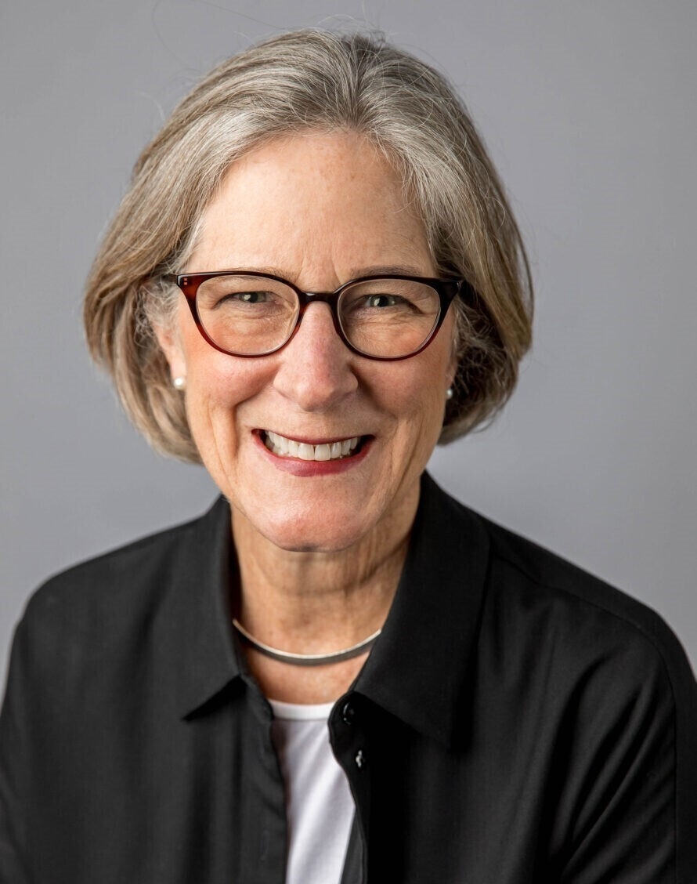
Presenter: Suzanne Shier
Suzanne Shier is Of Counsel in the firm’s Trusts & Estates Group. She is experienced in advising high net worth individuals and families in wealth, tax, business, and philanthropic planning. Her focus is on positioning clients to use their assets to achieve the desired impact, and she advises her clients to use their resources to fulfill the aspirations they have for their families, businesses, and communities. Suzanne’s clients include executives, entrepreneurs, professionals, family wealth owners, corporate fiduciaries, and charities with both domestic and international residence and assets. She has decades of experience both in private practice and with a leading global wealth management firm.
Suzanne is a frequent speaker and is regularly quoted in the media, including the Wall Street Journal, the New York Times, Penta, and Barron’s. She is the recipient of the Chicago Estate Planning Council Austin Fleming Distinguished Service Award, a fellow of the American College of Trust and Estate Counsel where she is the incoming chair of the International Planning Committee, and an Academician of The International Academy of Estate and Trust Law. Suzanne is an adjunct professor in the Northwestern Pritzker School of Law LLM in Taxation Program, where she mentors law students to use their talents to serve clients and the community.
She is active in the civic community, serving on philanthropic boards, concentrating on access to educational excellence at all levels. Suzanne serves on the Executive Committee of Kids Hope USA, Chicago Scholars Foundation, and Hope College. Suzanne’s greatest joy is her family – her husband, daughters, sons-in-law, and golden retriever. She enjoys spending time outdoors, including hiking, swimming, skiing, and snowshoeing.
Suzanne Shier Of Counsel Levenfeld Pearlstein, LLC
sshier@lplegal.com (312) 476-7505

Slide 52
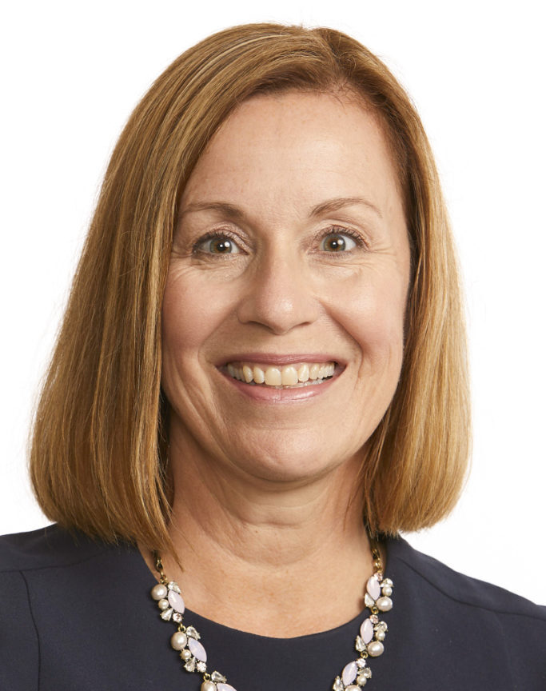
Presenter: Wendy Zimmer Cox
Wendy’s responsibilities include providing a trust perspective to all wealth management discussions, and coordinating planning strategies with other professional advisors, such as tax advisors or estate planning attorneys. She leads the personal trust team and is also responsible for day-to-day account oversight, fiduciary compliance and directing our team of trust relationship officers to ensure our clients receive remarkable service. Wendy practiced law for 16 years in the areas of probate and trust litigation, complex probate and trust administration, preparation of estate, fiduciary and gift tax returns, and drafting estate planning and business succession documents. She earned her B.A. and J.D. from the University of Michigan. Wendy is a designated Certified Trust and Fiduciary Advisor.
Wendy Zimmer Cox Director of Personal Trust, Chief Fiduciary Officer Greenleaf Trust
wcox@greenleaftrust.com (248) 530-6208

Slide 53
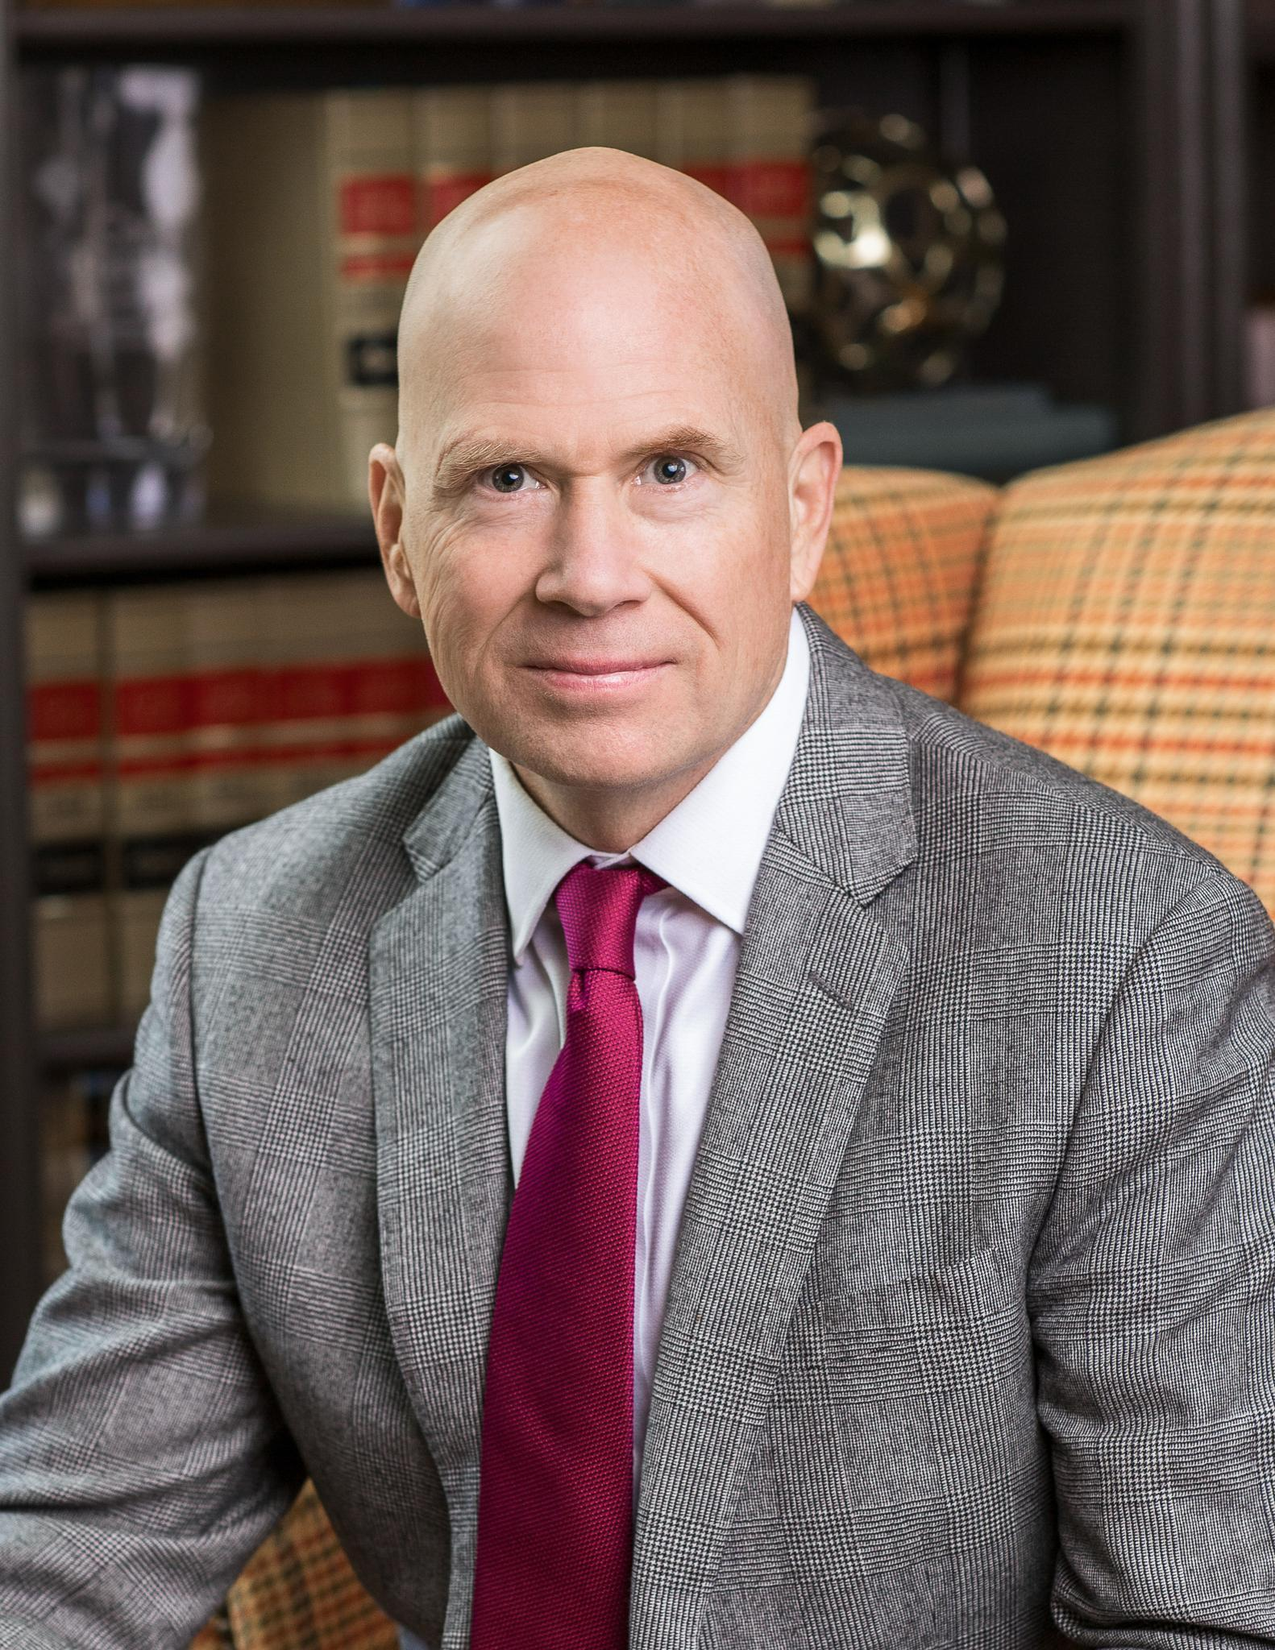
Presenter: Bill Kelleher
Bill Kelleher is a Director at Gordon, Fournaris & Mammarella, P.A. in Wilmington, Delaware. He focuses his practice on trust litigation in the Delaware Court of Chancery. He has taken to trial several high-profile trust disputes in that court. He also counsels trust companies on fiduciary duties and other related issues. Immediately upon graduation from law school, Bill spent four years on active duty as a judge advocate general in the United States Coast Guard. Thereafter he served as a judicial law clerk at the Delaware Court of Chancery. Bill has also served as a Deputy Attorney General for the State of Delaware. He has argued twelve times at the Delaware Supreme Court.
Bill Kelleher Director Fournaris & Mammarella, P.A.
bkelleher@gfmlaw.com (302) 652-1142

Slide 54
Disclaimer
These materials do not constitute and should not be treated as legal, tax or other advice regarding the use of any particular tax, estate planning or other technique, device or suggestion, or any of the tax or other consequences associated with them. Although reasonable efforts have been made to ensure the accuracy of these materials and the presentation, the authors do not assume responsibility for any individual’s or organization’s reliance on the written or oral information presented. Each reader and attendee should verify independently all statements made in the materials and presentation before applying them to a particular fact pattern and should determine independently the tax and other consequences of using any particular strategy, technique or suggestion before using it, recommending it to or implementing it for a client.

